Slide 1

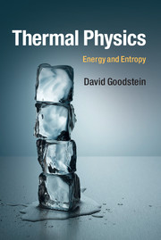
Thermal Physics: Energy and Entropy,
By David Goodstein
Recommended reading for:
Energy, Entropy and Numerical Physics(PHY2063)
Available at the Appleseed Bookshop at or better than Amazon price ~ why wait for your book?

